Slide 1
Other Income
Pub 17 Chapter 12
Pub 4012 Tab D
(Federal 1040-Line 21)
(NJ 1040 –Lines 23 & 25)
Notes:
1

Slide 2
Other Income Federal 1040 Line 21
Includes income not reported on other Lines & Schedules
Of info reported on 1099-MISCs, only Box 3 is included on 1040 Line 21
Amounts in other boxes go on other 1040 schedules, not Line 21 - e.g.
Box 1 (Rent) & Box 2 (Royalties) are entered on Sch E
Box 7 (Non-employee compensation, which is generally business income) must be entered on Schedule C
Notes:
2
For 1099-MISC, make sure to link to 1099-MISC from the line where you want income to appear. If you do not link from the appropriate Line 21, Sch C, or Sch E line, TW may put the income on an incorrect line & may not do all the appropriate calculations
For example, if 1099-MISC income for non-employee compensation is not linked from Sch C, TW will place the income automatically on 1040 Line 21 Other Income. TW will not calculate Self-Employment Taxes and the associated adjustment for the Deductible Part of Self-Employment Tax as it should

Slide 3
Other Income Types Federal 1040 Wkt 7 – 1040 Line 21
Gambling income
Jury duty income
Income as volunteer of medical studies
Prizes & awards
Recoveries
Poll attendant
Notes:
3
If you get a W-2 for any of these types of income, you must include it on 1040 Line 7 Wages

Slide 4
Gambling Income (Federal)
Gambling winnings must be included in Other Income on 1040 line 21
For taxpayers who itemize, gambling losses can be deducted up to amount of winnings on Schedule A
End-of-Year Tax Statement:
W-2G (sent out if winnings are > $600)
Notes:
4

Slide 5
Gambling Income (NJ)
Losses are deducted from winnings before including on NJ 1040 Line 23 (net)
TW handles if losses are included on TW W-2G
NJ Lottery winnings of $10,000 or less per occurrence are not taxable in NJ
TW does not include in NJ income if box on TW W-2G “See F-1 Help on the state return…….” is checked
Lottery winnings from other states are fully taxable

Slide 6
Sample Gambling Winnings – W-2G
04/15/2014
Atlantic City, NJ 08404
609-555-5555
Diane Davis
123-06-4139
210 Main Street
Notes:
This is a sample W-2G for gambling winnings
6

Slide 7
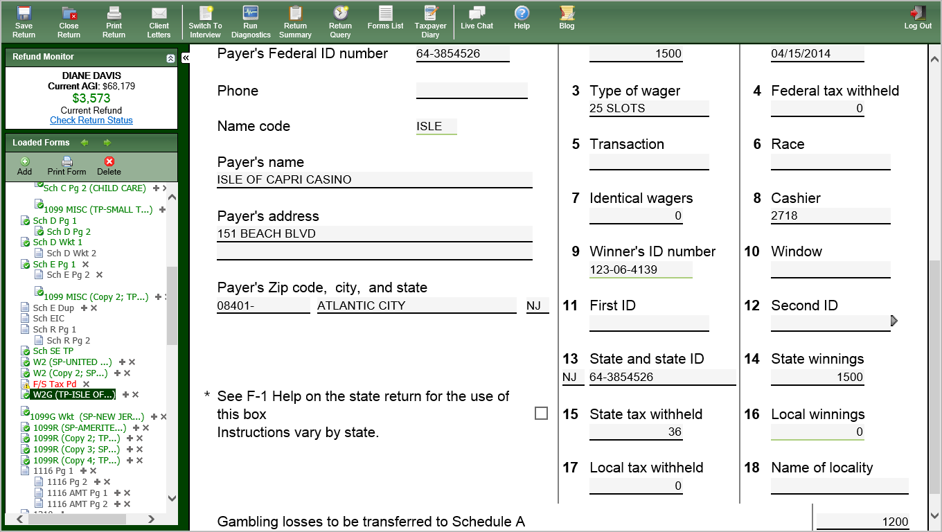
TW Gambling Income – W-2G
Use for NJ lottery winnings </= $10,000
Gambling losses
Notes:
7
Pull up W-2G Certain Gambling Winnings screen
Link from Line 21 on 1040 Page 1 (using arrow or F9) to Wkt7. From Line 1 on Wkt7, link to W-2G. If Gambling form is not listed under Existing tab, try New tab OR
Go directly to W-2G Certain Gambling Winnings screen by clicking on W2G in Forms Tree
Check whether W-2G is for taxpayer or spouse
Enter Payer’s Federal ID #. If TW does not bring up payer’s name & address, type in
TW should populate winner’s name & address since you checked Taxpayer or Spouse
Enter data from printed W-2G into appropriate boxes on screen
If winnings are from NJ Lottery & are </= $10,000, check “See F-1” box. TW will exclude lottery winnings from NJ income
You can remember when to check the “See F-1” box by remembering that TW automatically transfers the gambling income to NJ
If you want to exclude lottery winnings <= $10K from NJ income, tell TW to do so by checking box
If TW does not need to exclude lottery winnings > $10K from NJ income, then counselor does not need to do anything either
Enter total gambling losses. TW calculates how much to put on Sch A (up to amount of winnings). TW will also calculate net winnings for NJ 1040
TW will enter total gambling winnings on Line 1 of Wkt 7 & then transfer winnings to 1040 Line 21
TW will transfer losses to Sch A Line 28 Other Misc. Deductions, up to amount of winnings
TW will enter Net Gambling Winnings on Line 23 of the NJ 1040

Slide 8
Gambling Income - TW Tips
Federal 1040 Line 21 - link to 1040 Wkt 7 Line 1; then link again to W2-G Gambling Winnings screen
Enter required information
Be sure to enter all data from printed W-2G into appropriate boxes on screen
If winnings are from NJ Lottery & winnings </= $10K, check “See F-1” box. TW excludes this from NJ income
Enter total gambling losses on bottom (TW calculates how much to put on Sch A Line 28 - up to amount of winnings)
TW will populate Total Gambling Winnings on Line 1 of 1040 Wkt 7 and then transfer to Federal 1040 Line 21
TW will populate Net Gambling Winnings on NJ 1040 Line 23
Notes:
8

Slide 9
Jury Duty Pay
Jury Duty Pay must be included in Other Income on 1040 line 21
Enter on 1040 Wkt 7 Line 14 & TW will transfer to 1040 Line 21
Some employers pay taxpayers during jury duty periods & require jury duty compensation to be turned over to them
Deduct amount returned to employer on 1040 Line 35
Notes:
9

Slide 10
Recoveries
Pub 17 Chapter 12
Recoveries of amounts deducted in prior years may have to be reported as Other Income in current year. May include:*
Property tax rebates (e.g. - PTR & Homestead Benefit) – covered in more detail in later slides
Reimbursements for medical expenses claimed in prior years
Other refunds of Schedule A deductions
For property tax rebates, link to State Tax Refund Worksheet in TW off 1040 Line 10 to determine how much of recovery is taxable (if prior year info is available)
NJ property tax recoveries are not taxable in NJ. Adjust NJ 1040 Line 25 using negative amount on NJ Supplementary Schedule of Other Income, Line F
*NJ Income tax refunds are reported on Federal 1040 Line 10, not Line 21
Notes:
Handling of property tax recoveries will be handled in a separate module later in training
10

Slide 11
Net Operating Loss on Federal 1040 Wkt 7
Net operating losses are OUT OF SCOPE
There are situations on carry-forward returns where a NOL is carried forward to Wkt 7 line 15
You will notice this when a newly created return (with automatic carry-forward data from prior year) has 1040 Wkt7 red in the tree
See Special Topic document “Handling Net Operating Loss (NOL)” on TaxPrep4Free.org Preparer page for how to handle this situation

Slide 12
Cancellation of Credit Card Debt
Cancellation of credit card debt is in scope for all counselors as part of Advanced certification
Reported on 1099-C
1099-C income taxable on Federal return
Exception: taxpayer in bankruptcy or insolvent (liabilities exceeded assets) immediately before debt was cancelled
If bankrupt or insolvent, Out of Scope
Entered on 1040 TW Wkt 7. TW transfers to 1040 Line 21
1099-C income is not taxable in NJ
Adjust NJ 1040 Line 25 using negative amount on NJ Supplementary Schedule of Other Income, Line F
See Pub 4012 page D-32 and specific instructions in Special Topics document on TaxPrep4Free.org Preparer page
Notes:
12

Slide 13
Cancellation of Credit Card Debt – 1099-C
Notes:
13

Slide 14
Cancellation of Credit Card Debt – TW 1040 Wkt 7 Other Income Worksheet for 1040 Line 21
Notes:
14

Slide 15
Income from Long-Term Care Insurance Contracts
Income received from Long-Term Care Insurance Contracts is in scope
Generally reimbursements are not taxable
Per diem costs up to an aggregate limit are not taxable
Reported on 1099-LTC
Enter in TW on Form 8853 by linking from 1040 Wkt 7 Line 11
Form 8853 Section C is in scope; sections A and B are not
See specific instructions in Special Topic document on TaxPrep4Free.org Preparer page
Notes:
15

Slide 16
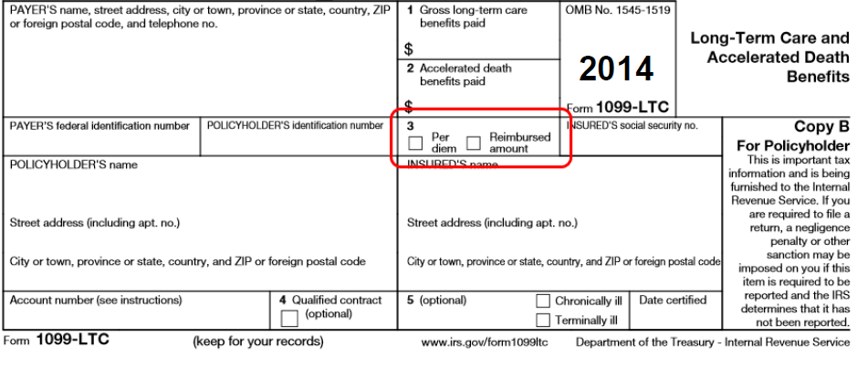
Long-Term Care Insurance Contracts – 1099-LTC
Notes:
Box 3 tells you whether long-term care insurance contract income is a per diem amount or a reimbursed amount
Per-diem plan payments are not taxable up to $330 per day. If per-diem payments received are less than $330 per day, the payments are excludable from gross income
Reimbursed amounts that are less than the actual cost of qualified care are excludable from gross income
16

Slide 17
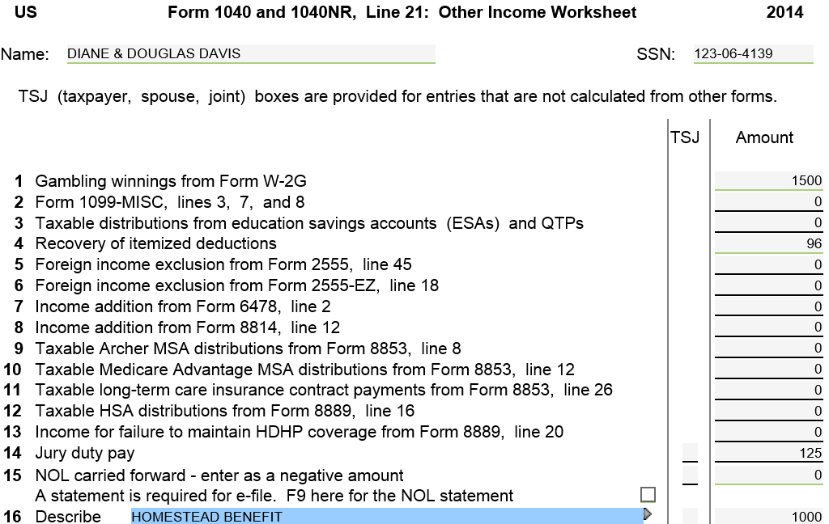
TW Other Income – Federal 1040 Wkt 7
Gambling winnings
from W-2G
PTR recovery from St Tax Refund Wkt
Income from L/T Care Contract
Jury duty pay
NOL carried forward
Homestead Benefit recovery
Notes:
Pull up 1040 Wkt 7
Link from Line 21 on 1040 Page 1 (using arrow or F9) OR
Go directly to 1040 Wkt 7 in Forms Tree
Enter amount of Other Income on appropriate line. If no specific line for the type of income, enter on blank lines (starting with Line 16) with a descriptive identifier (e.g. – “Homestead Benefit”)
Some types of Other Income should be entered on specific forms rather than directly on 1040 Wkt 7 (e.g. – gambling winnings on W-2G form, certain other income shown on 1099-MISC). Once entered on the specific forms, TW will transfer info to appropriate 1040 Wkt 7 line
TW will transfer info from 1040 Wkt 7 to 1040 Line 21
17

Slide 18
TW Other Income – Federal 1040 Line 21
Other income from
1040 Wkt 7
Notes:
18

Slide 19
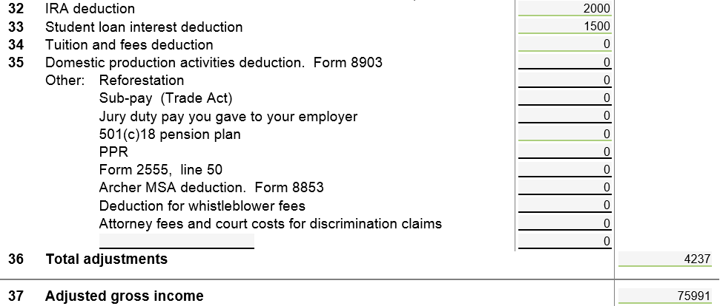
TW – Jury Duty Pay You Gave to your Employer – Federal 1040 Line 35
Notes:
Some employers pay taxpayers during jury duty periods & require jury duty compensation to be turned over to them
On 1040 Line 35, enter the amount taxpayer had to return to employer
19

Slide 20
Adjusting NJ Line 25 for Property Tax Recoveries or Cancellation of Debt (1099-C)
Property Tax Recoveries & Cancellation of Debt amounts may be taxable for Federal return, but are not taxable for NJ
TaxWise will carry taxable amount from Federal 1040 Line 21 Other Income to NJ 1040 Line 25
NJ return is adjusted by putting a negative amount on “Line 25: Supplementary Schedule of Other Income,” line F “Other”
Link from NJ 1040 Line 25. Also enter identifier

Slide 21
Adjusting NJ Line 25 for Property Tax Recoveries or Cancellation of Debt (1099-C)
Line 25: Supplementary Schedule of Other Income
Attach a scratch pad here with the PTR, HB &/or COD amounts as negative numbers
Notes:
Open “NJ Other Income” at the bottom of the NJ Tree. The form “Line 25: Supplementary Schedule of Other Income” will appear
Attach a scratch pad to line F with the amount of the PTR, HB and/or COD amounts as negative numbers

Slide 22
After Adjusting NJ Line 25 for Property Tax Recoveries or Cancellation of Debt (1099-C)
Net gambling winnings (winnings minus losses)
Only taxable Other Income left (jury duty) after
Adjustments for nontaxable PTR, HB, & COD

